Slide 1

How do Organisms
Reproduce?
Modes of reproduction used by single organisms
(Budding, Fragmentation)

Slide 2
Budding
Seen in Yeast
A small outgrowth is formed on the parental cell
The nucleus of the parent cell divides
The bud increases in size
The bud separates & grows further
& one daughter nucleus migrates into the bud

Slide 3
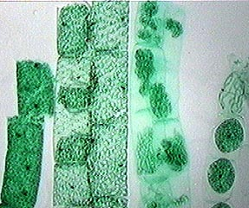
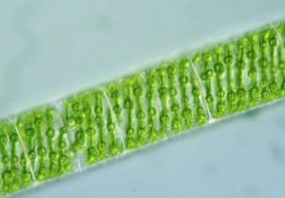
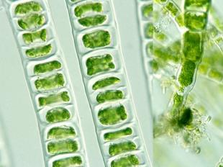

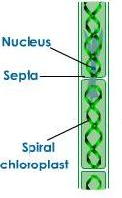
Fragmentation
The act or process of breaking into fragments (piece)
Seen in multi-cellular organisms with simple body organisation.
For eg- spirogyra, ulothrix.
On maturation the fragment breaks up into smaller pieces.
These pieces or fragments grow into new individuals.
new individual
new individual

Slide 4
Thank You

